Slide 1
Learning from intergenerational housing projects in the USA Dr Emma Garland Winston Churchill Fellow

Slide 2
Fund British citizens to travel overseas in pursuit of new and better ways of tackling a wide range of the current challenges facing the UK.
Successful applicants are known as Churchill Fellows for life.
No qualifications are required, just a project and the desire and motivation to improve your community, profession or field.
http://www.wcmt.org.uk/

Slide 3
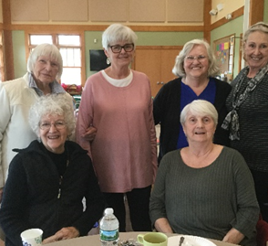
Aims and objectives of my research trip
To learn more about the different models of intergenerational housing in the USA.
To consider whether and how these could work in a UK context.
To provide a practical tool for anyone in the UK considering setting up an intergenerational housing scheme.
To stimulate debate about the type of housing we should be building in the UK and to encourage consideration of intergenerational housing alongside more traditional models.

Slide 4
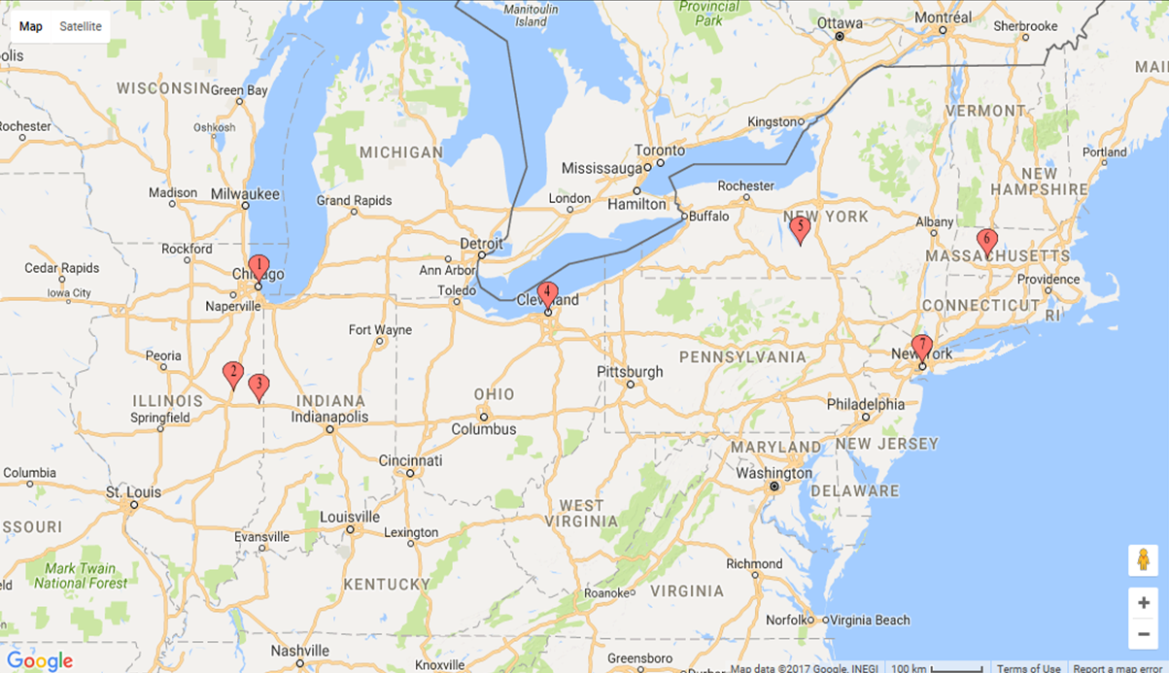
Where did I go?
During my four-week trip in October 2017, I visited:
Nine different intergenerational housing schemes
Organisations that deliver intergenerational activities and programmes
Non-profit organisations providing supportive services to local communities
Local housing authorities
Interviewed staff and residents to see how they worked in practical terms and to find out what people thought about living & working there.

Slide 5
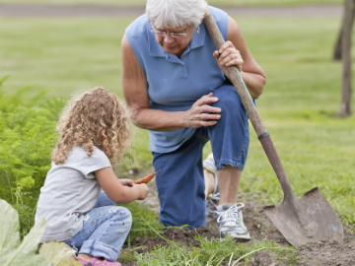
What is intergenerational housing?
Provides a safe living space for people of all ages to interact, collaborate and explore the values of each generation on an ongoing basis.
Enables people of different ages to live side by side as good neighbours, to share their talents and resources, develop meaningful relationships and support each other;
Fosters programs, policies, and practices that promote engagement, cooperation, interaction, and exchange between residents of different generations;
Provides adequately for the safety, health, education and basic necessities of life for people of all ages, by taking a partnership or community-led approach to the delivery of services and/or activities;
Has private and communal spaces intended for collective use.

Slide 6
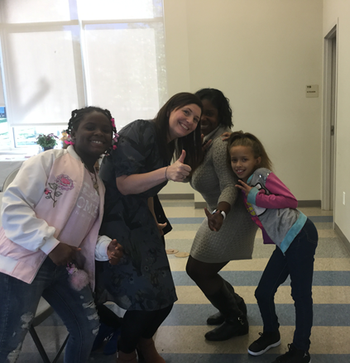
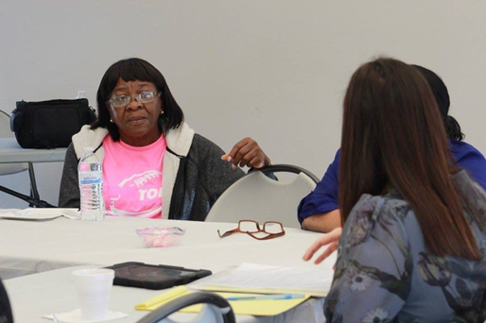
What will I talk about today?
Today I’ll focus on intergenerational housing where support is provided:
Two schemes where foster and adoptive families live alongside older people
Three ‘Grandfamily’ housing schemes which house grandparents with parental responsibility for grandchildren

Slide 7
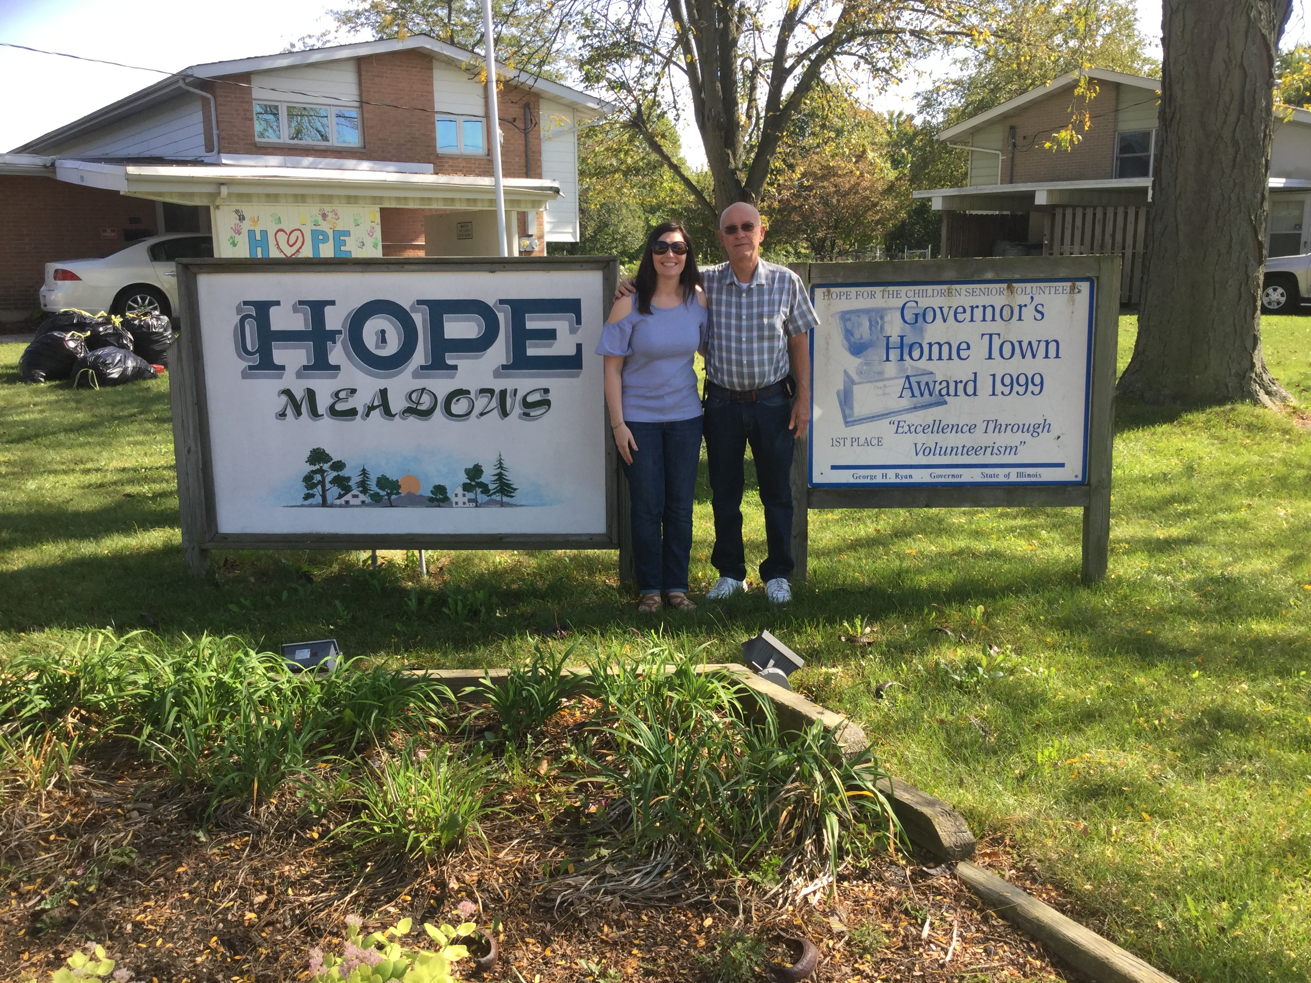
Intergenerational housing for families fostering or adopting children and older people
The Treehouse, Easthampton Massachusetts
Hope Meadows, Rantoul, Illinois
Aim: to “stop the bounce” – to end the cycle of foster children being moved from home to home by creating permanency, community and supportive relationships.
Based on the community-as-intervention model.
Model has been adapted for other groups needing support.
Notes:
One purpose built and one converted from old Air Force base
Residents get their own homes of various sizes
Village-like feel
Unfenced and plenty of open spaces
Many shared spaces:
Community centre
Children's library
Computer room
Rooms for individual tutoring
Kitchen
Playroom
Open spaces
Playground

Slide 8
Older residents
How it works:
Seniors are required to provide six hours volunteering per week supporting parents and their children as “honorary grandparents”
In return, pay below market rent for homes
Must be able-bodied and age 55 or older, ready to babysit, drive, tutor and, mostly, love the kids who live there
Receive training in how to deal with foster children
Why did they want to live there?
Some had relevant experience, e.g. social work, nursing, school teachers
Liked the idea of an intergenerational community and wanted to help the kids
Wanted to make a difference / continue to contribute / give back
Wanted to feel productive and keep active
Wanted to be around others
Didn’t want to live just with people of the same age

Slide 9
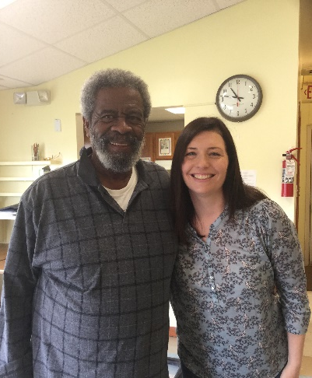
Mr Jim

Slide 10
What’s it like to live there?
“One loving family” and a “ Caring community”
Everyone knows each other and says hello
All work together to support children
Staff facilitate bringing together different age groups so they can get to know one another but do not ‘make friendships happen’
Children and seniors regularly socialise together
Seniors give piano lessons, chaperone field trips, take children to ballet and soccer practice, walk children to school, sew quilts, host sleepovers, go fishing and babysit
Always something going on - monthly get-togethers, dance classes, yoga, sharing meals, theatre groups, photography courses and after-school program

Slide 11
Has it made a difference?
Children and young people:
Parents:
Support from older residents – someone to rely on
Reduced stress and economic benefits

Slide 12
Has it made a difference?
Older residents:
No decline in mental, physical or emotional health
Increases in quality of life
Self-esteem and life satisfaction
Ability to live independently on fixed or decreasing incomes
Reduced isolation and expanded social connections
Why?
Felt they were making a difference in the lives of others
Makes you get up, get out and do things – helps to keep you active
Real neighbours– make friends and makes you get out
Look out for each other
Feel connected but don’t have to join in
Keeps you young – get to mix with different ages
Love the kids!

Slide 13
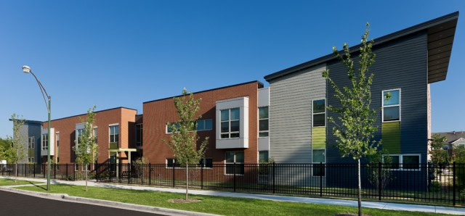
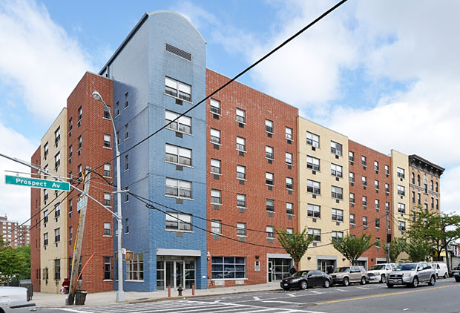
Grandfamily housing
Roseland Village, Chicago
Griot Village, Cleveland, Ohio
Supportive housing for grandparents with legal custody of grandchildren
PSS/WSF GrandParent Family apartments, South Bronx

Slide 14
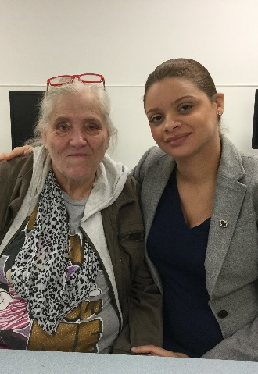
Why is it needed?
More than 2.4 million grandparents across the USA have responsibility for grandchildren
Face multiple challenges – poor physical and mental health, depression, struggling on a low income, difficulty enrolling kids in school
Housing – key problem!
Excluded from age-designated housing
Can’t afford decent, safe accommodation
Often face eviction

Slide 15
Common features
Grandparents submit their application which is then screened to check if they meet eligibility criteria and they may undergo an interview
Homes are designed to meet the needs of older adults and children
An on-site resource or community centre including a large open area, a kitchen and an ICT suite
Outdoor green spaces and play areas
Located near to public transportation, commercial and/or retail development, hospitals or medical centres and schools
Residents were involved in the planning and design of the development
Supportive services are provided – these are seen as essential to the success of the projects
Dedicated staff such as resident services co-ordinators, social workers, youth program specialists, family caregiver support worker
Notes:
There is usually an upper age limit, both for grandparents and children
Grandparents must have a legally sanctioned care relationship with each child
Grandparents must be on a low income
Grandparents must understand the concept of grandfamily housing and that alternative accommodation will be needed once the children ‘age-out’ (i.e. become adults)

Slide 16
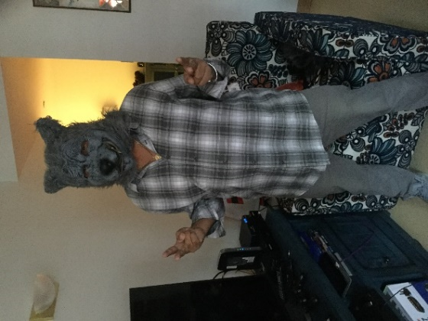
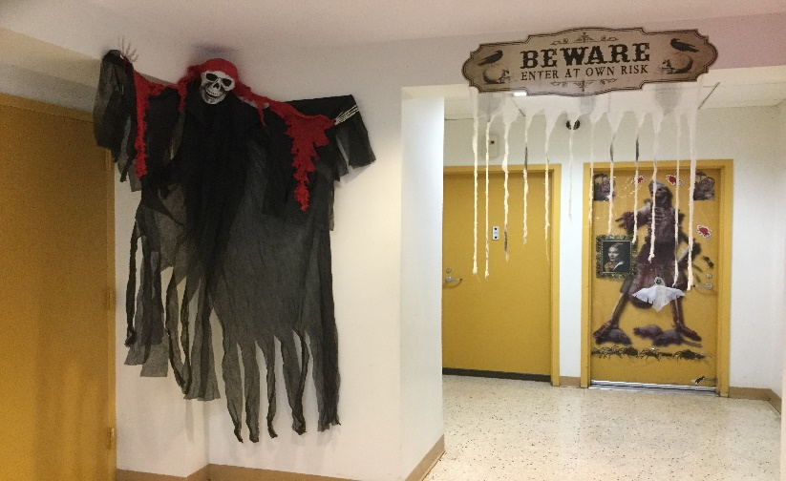
Activities and programs
Halloween at PSS/WSF GrandParent Family Apartments. Families worked together to decorate the building and grandparents helped to organise a Halloween party for the children. Here you can see 62-year-old Peter who dressed up as a werewolf!
Notes:
Activities, events and programs are mainly organised by staff, but are based on what residents say they need or would like
Some are aimed at just one age group, whereas others aim to bring all the community together, such as gardening programs

Slide 17
Has it made a difference?
Children and young people
“A phenomenal place to live…I have a home and we can be a family”.
Having the privacy of their own room and space, which makes them feel happier and more secure
Living alongside others who are going through a similar experience
More opportunities and improved educational attainment
Being supported as their grandparents get older and roles are reversed.
Notes:
jaziah

Slide 18
Has it made a difference?
Grandparents
Safe, clean, good quality housing = stability and less worried
Makes life easier for them = physical and mental health benefits
Better able to support grandchildren and cope with situation
Peer support invaluable = reduced loneliness and isolation & expanded circle of friends
“I was in an apartment that was $900 a month plus utilities. Trying to pay that kind of rent on a fixed income is rough. This building was a blessing. I’m grateful not to drag laundry to the laundromat on the bus.”
Grandmother Doris at Roseland Village

Slide 19
Common themes and lessons learnt
Having a sense of purpose was important – social glue
You need the right residents to make it work
Notes:
Careful selection of residents based on their motivation for wanting to live there
Often in conjunction with people already living there
Sometimes preference given to people with particular qualifications and/or experience, e.g. in education, community or social work
Stringent pre-tenancy checks
Clear on ground rules or expectations at an early stage
Trial visits enable both parties to check they are the right fit.
Important that activities and programs / life there is resident led but…
Need staff to help facilitate relationship building
Consider commitment and motivation of staff
Plan for community aging
Plan for transition arrangements

Slide 20
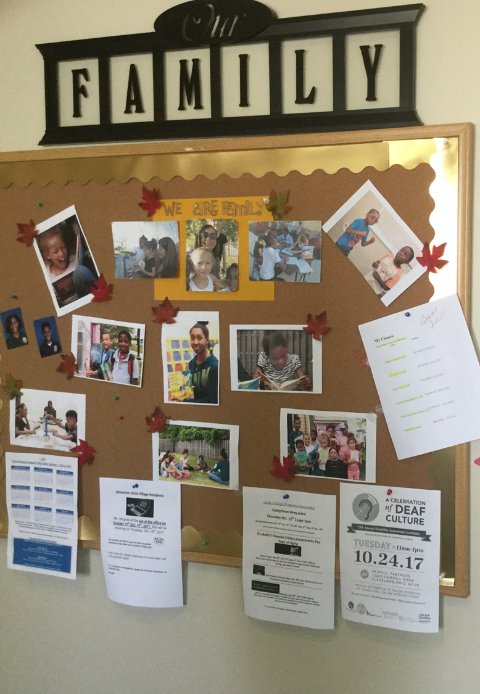
Key findings
Intergenerational housing works particularly well as a model for supported housing
It fosters the creation of friendly, neighbourly, supportive communities where residents of all ages engage and interact on a regular basis
It can bring many benefits and a range of positive outcomes to individuals, the community and the state

Slide 21
Thanks for listening.
You can contact me via the following methods:
Blog: www.intergenerationalhousingblog.wordpress.com
Twitter: @intergenhousing
More about me: https://uk.linkedin.com/in/dr-emma-garland-40872028
Report available: https://www.wcmt.org.uk/users/emmagarland2016

